Slide 1
Used Car Listing Price Prediction
Presented by Team 13​

Slide 2
AGENDA
The Case​ and Business Application
Where we left last time ?
Missing Data analysis
​Next Steps

Slide 3
The Case
Every day, on an average, 20,630 used cars were sold in the UK in 2019. The sales prices are determined by the supply-demand curve equilibrium. Obviously, the customer would want the best price for the vehicle and the buyer would also want the best deal. Our job is to predict the best sales price so that both the buyer and seller get optimum value.
Primary Goal:
To predict listing price of used cars based on previous datasets available using relevant analysis models and tools.
For this, we need to:
Find a relevant dataset
Clean the data
To find out various features of a car that are relevant for a customer and analyze their effects on the list price

Slide 4
Business application
We plan to sell our price prediction tool to websites and applications that are marketplaces for used cars so that the seller can effectively predict the optimum listing price for their vehicle and accordingly decide the price they would like to list their vehicle for. Our direct customer shall be the websites and applications making it a B2B product.

Slide 5
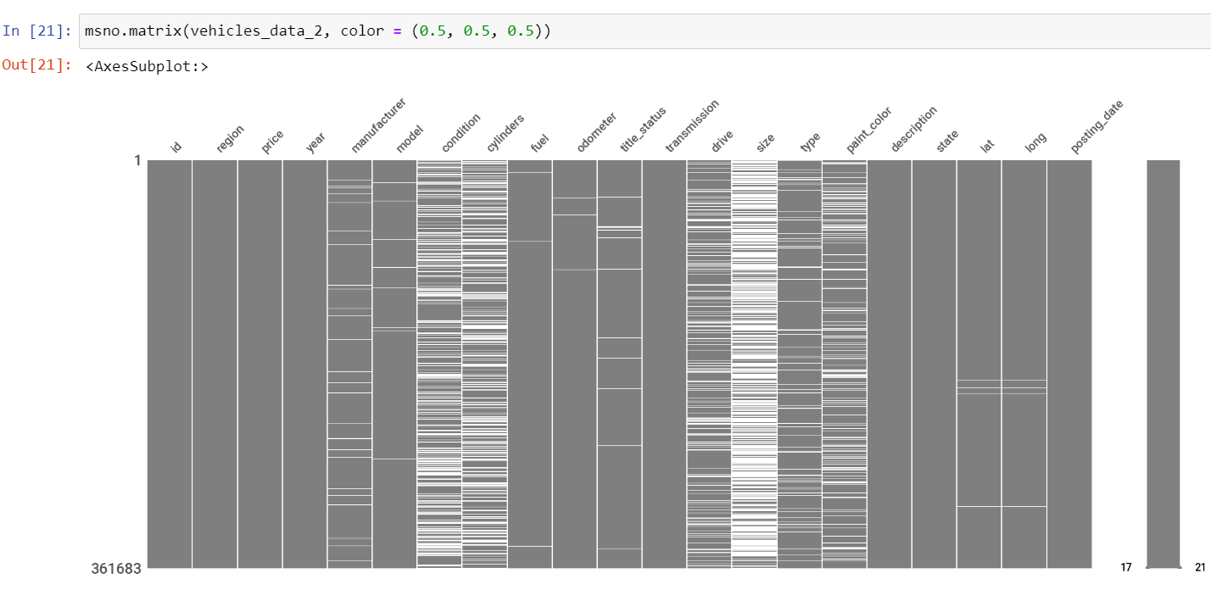

Slide 6
Missing Values Approximation -- features-Wise ( > 10%)
condition → ~32%
cylinders → ~ 32%
drive → ~ 20%
Size → ~ 67%
Paint_color → ~20%

Slide 7
Missing Values Investigation
Primary objective after EDA is to investigate a pattern in missing of data.
Missing at random or missingness has any pattern
Algorithms and methods investigated –
DBSCAN → not used further as this is used primarily for ‘float’ values
K-Prototype
Chi-Squared test → In progress
Mean/Median/St Dev for Sales price → In progress

Slide 8
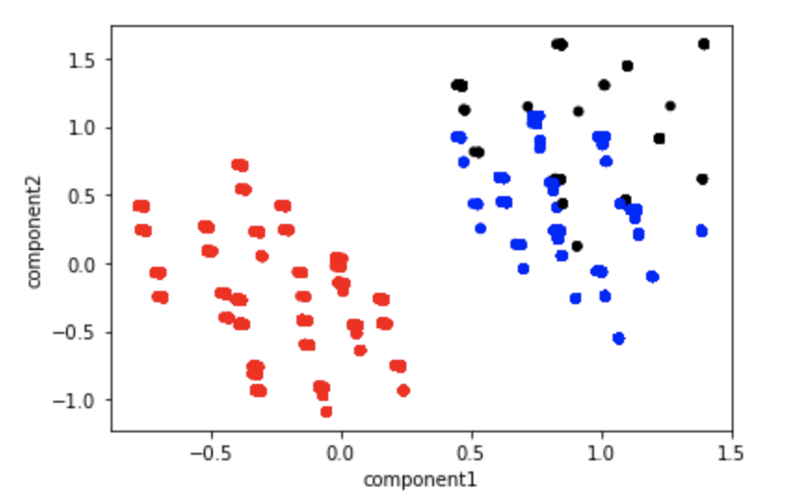
K-Prototype (1 of 3)
K-Prototype clustering is mainly used for clustering analysis of categorical variables
Converted whole dataset into “True” and “False” values.
True -> If value is missing
False -> If value is present
Executed for 3 clusters

Slide 9
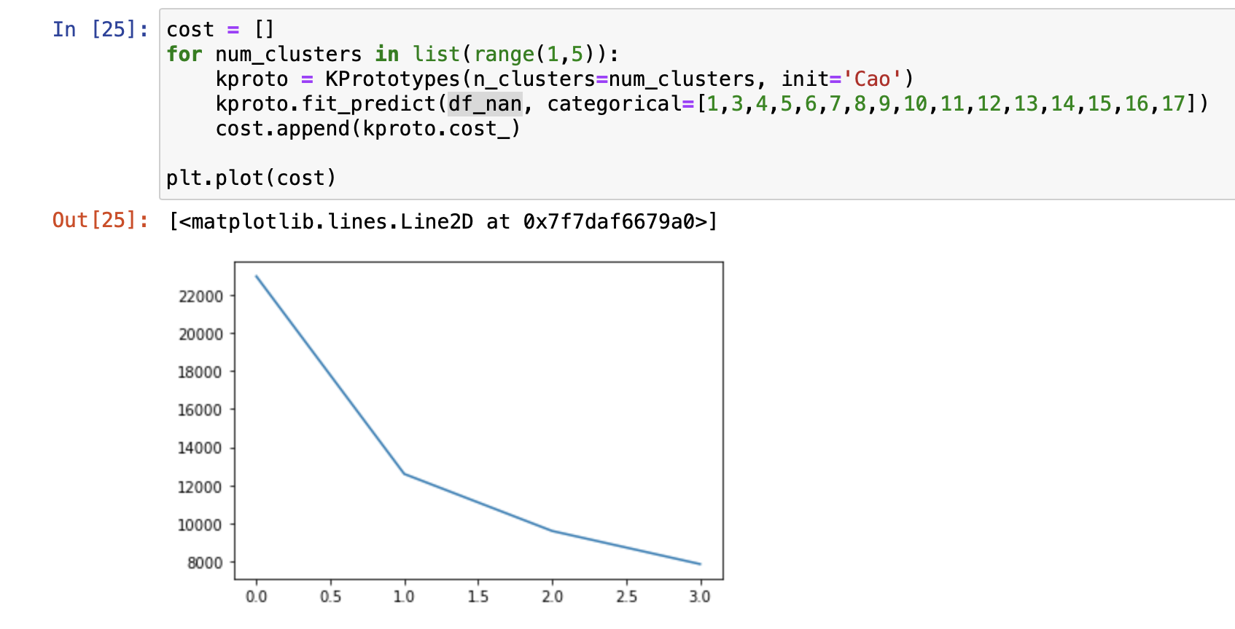
K-Prototype (2 of 3)
Created a new data frame with at least one null value (df_nan)
Executed Elbow test to find the optimum number of clusters on df_nan

Slide 10
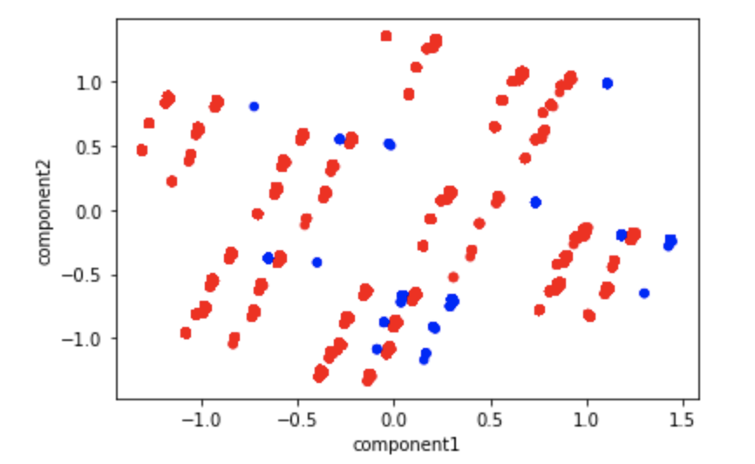
K-Prototype (3 of 3)
K-Prototype with Clusters K=2

Slide 11
Chi-SquareD Test
 | Condition | Cylinders | Drive | Size | Paint_color
Condition |  | 658.9739334 | 10799.67596 | 4923.854797 | 863.9486165
Cylinders |  |  | 6530.764661 | 2602.976346 | 2252.517055
Drive |  |  |  | 91.55149234 | 42.98858865
Size |  |  |  |  | 2332.228253
Paint_color

Slide 12
Next Steps …
Group the data according to distinct combination of True and False for problematic 5 variables and find the count of each entry -→ DONE
Find the vital stats of Sales Price for each of above row → Mean, Standard Deviation and Median
Apply Multiple imputer (MICE) if missingness has no observed pattern

Slide 13
THANK YOU
Chirag Murali
Dhruv
Rachit Jain
Riya Mangal
Snehal Srivastava

